Slide 1
EMPLOYEE SALARY PREDICTION USING STREAMLIT & MACHINE LEARNING
CAPSTONE PROJECT
Presented By:
Anjali Kalas
Moodlakatte Institute Of Technology,Kundapura
Artificial intelligence & Machine learning

Slide 2
OUTLINE
Problem Statement (Should not include solution)
System Development Approach (Technology Used)
Algorithm & Deployment (Step by Step Procedure)
Result
Conclusion
Future Scope(Optonal)
References

Slide 3
Problem Statement
Inconsistent manual salary estimations affect hiring decisions.
Traditional methods lack data-backed precision.
The goal: build a fast and reliable salary prediction tool using ML.
Predict salaries based on years of experience using a trained model.
Deploy the tool as a user-friendly web app for practical use.

Slide 4
System Approach
System Requirements:
Laptop/Desktop with Python & Streamlit installed
CSV file: adult 3.csv
Libraries Used:
pandas, numpy, scikit-learn, joblib, streamlit
Technologies:
Python for data handling & modeling
scikit-learn for Linear Regression
Streamlit for UI
Joblib for model saving

Slide 5
Algorithm & Deployment
1. Load the dataset (adult.csv)
2.Rebuild the missing Salary column using:
data["Salary"] = data["YearsExperience"] * 10000 + np.random.randint(-3000, 3000, size=len(data))
3. Define features (YearsExperience) and target (Salary)
4. Split data into training and testing sets
5. Train a Linear Regression model
6. Evaluate and save the model using Mean Squared Error (MSE)
7. Build a Streamlit app to take input and show predicted salary
8. Run the app using: streamlit run app.py

Slide 6
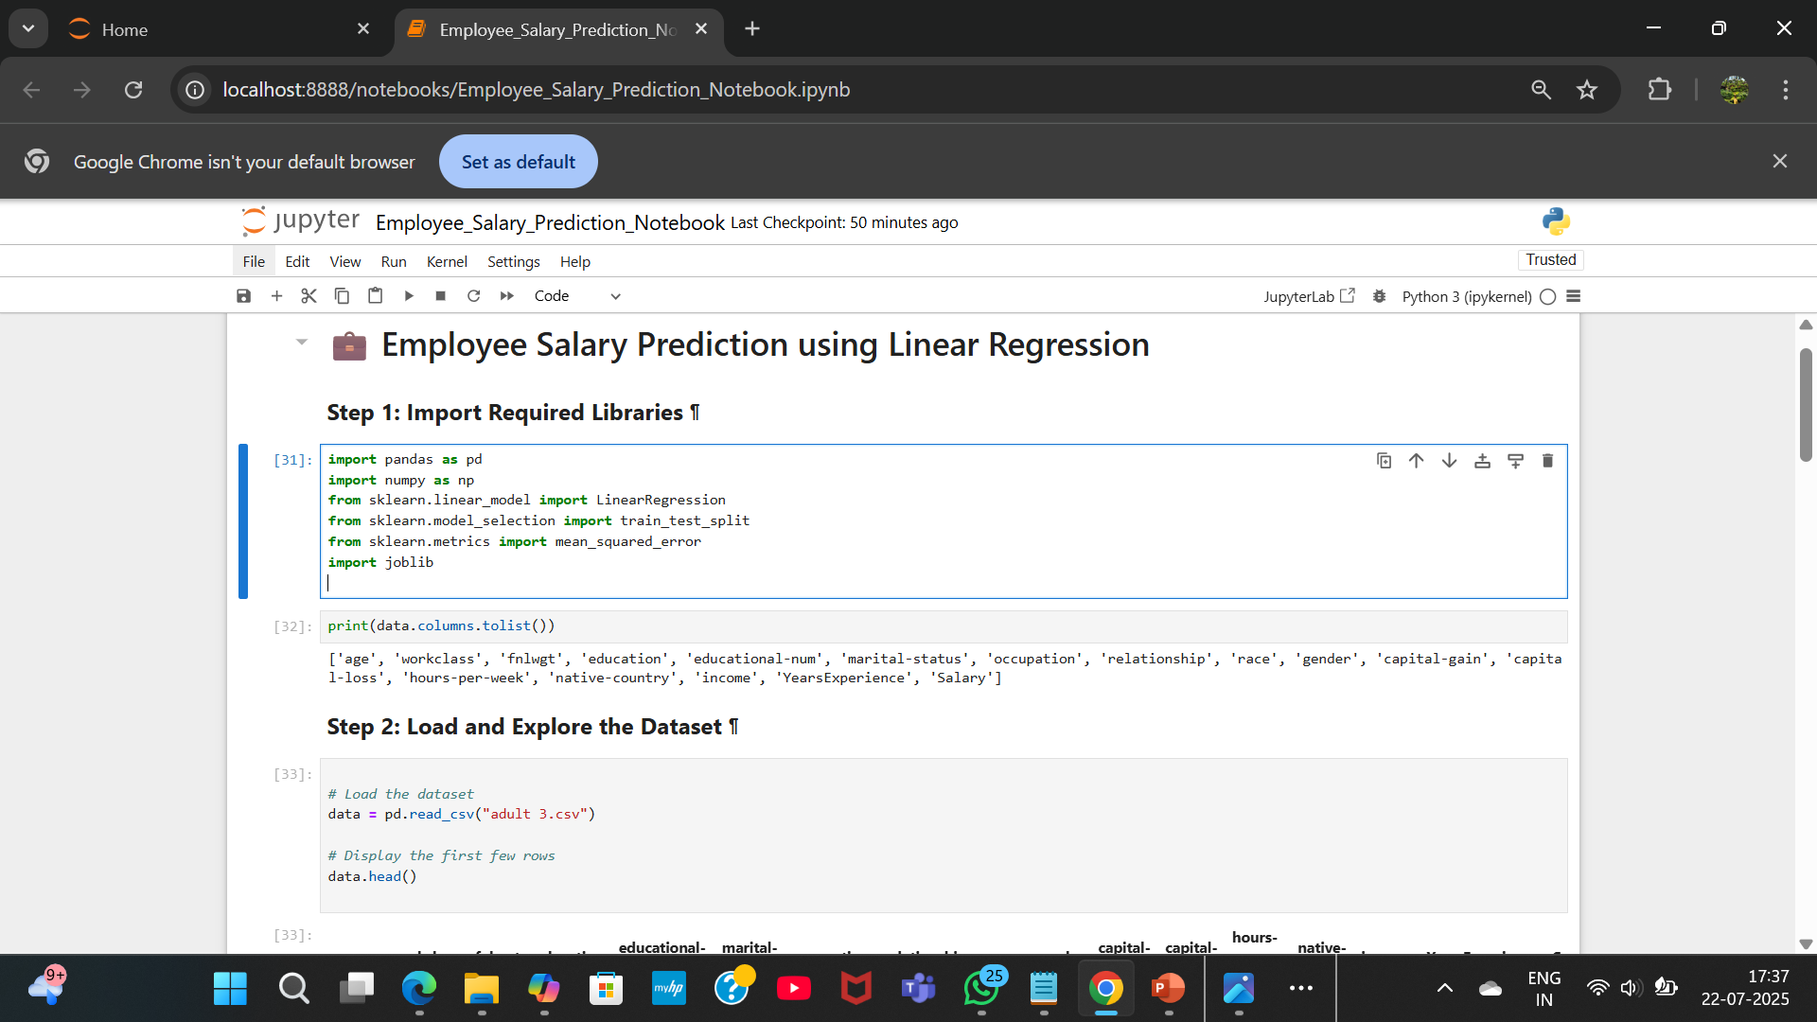
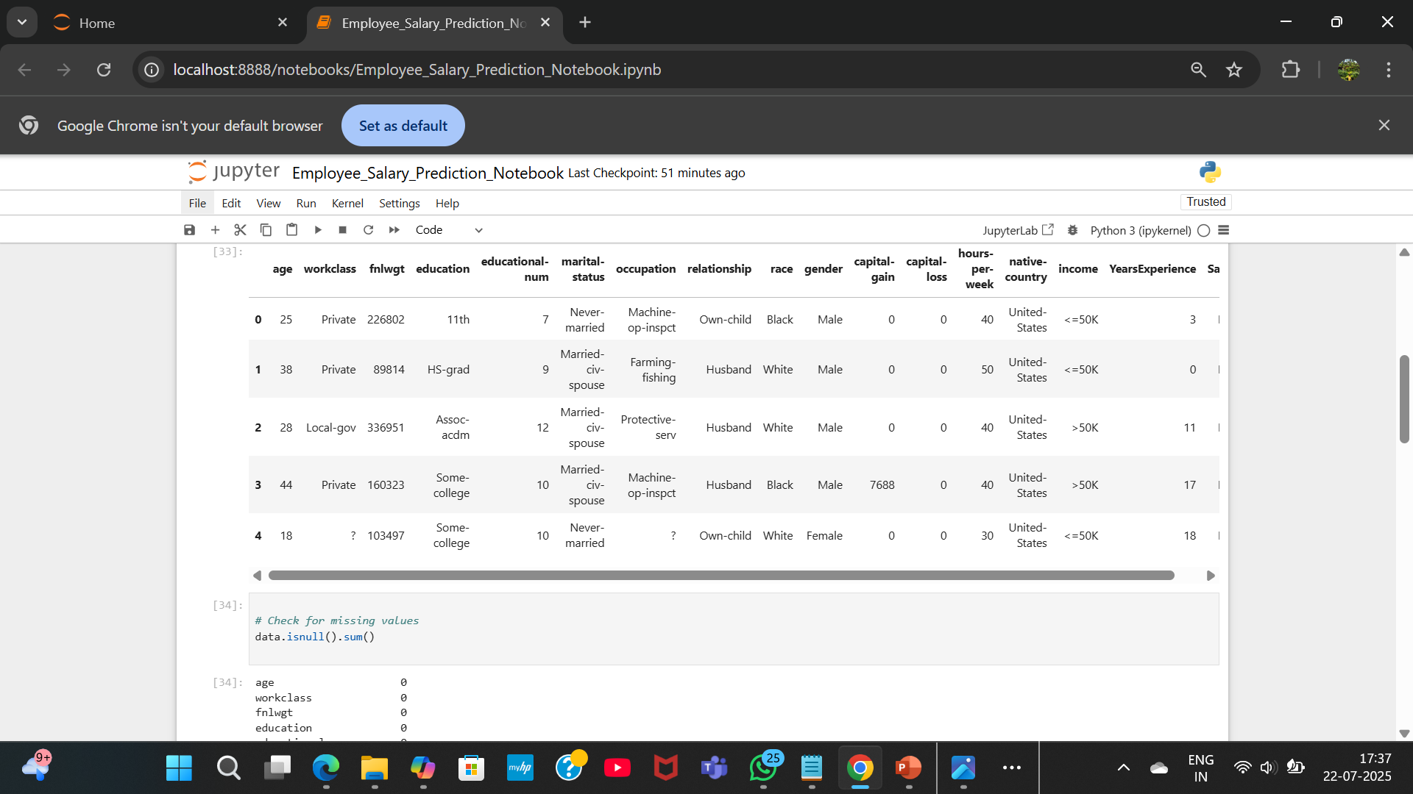
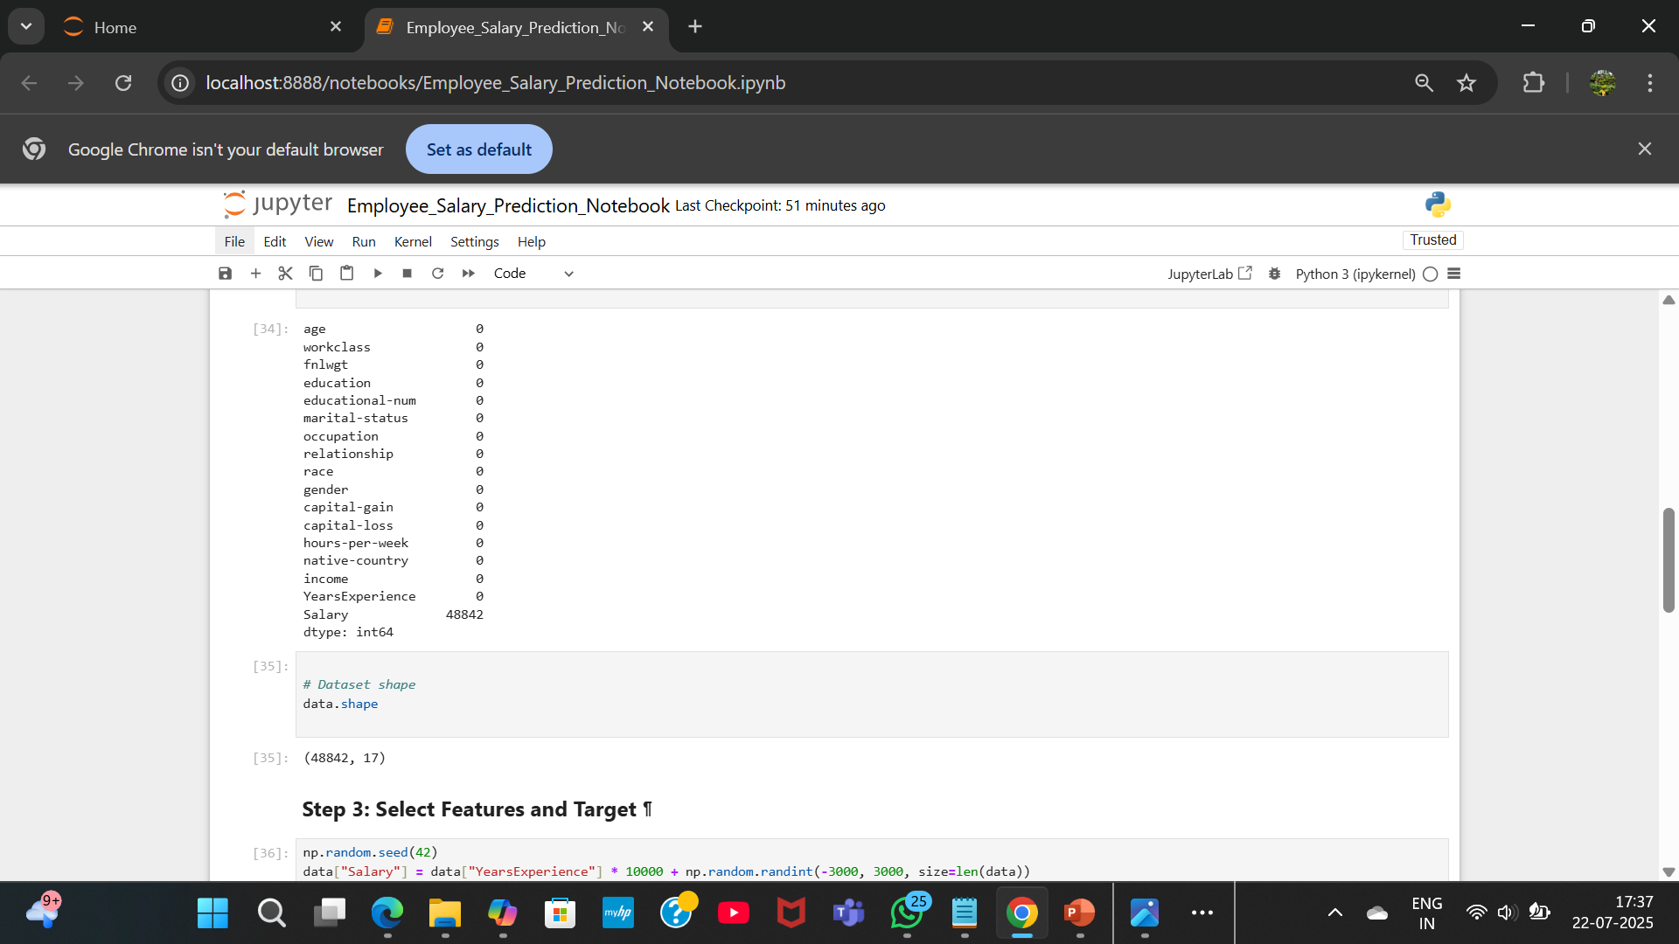
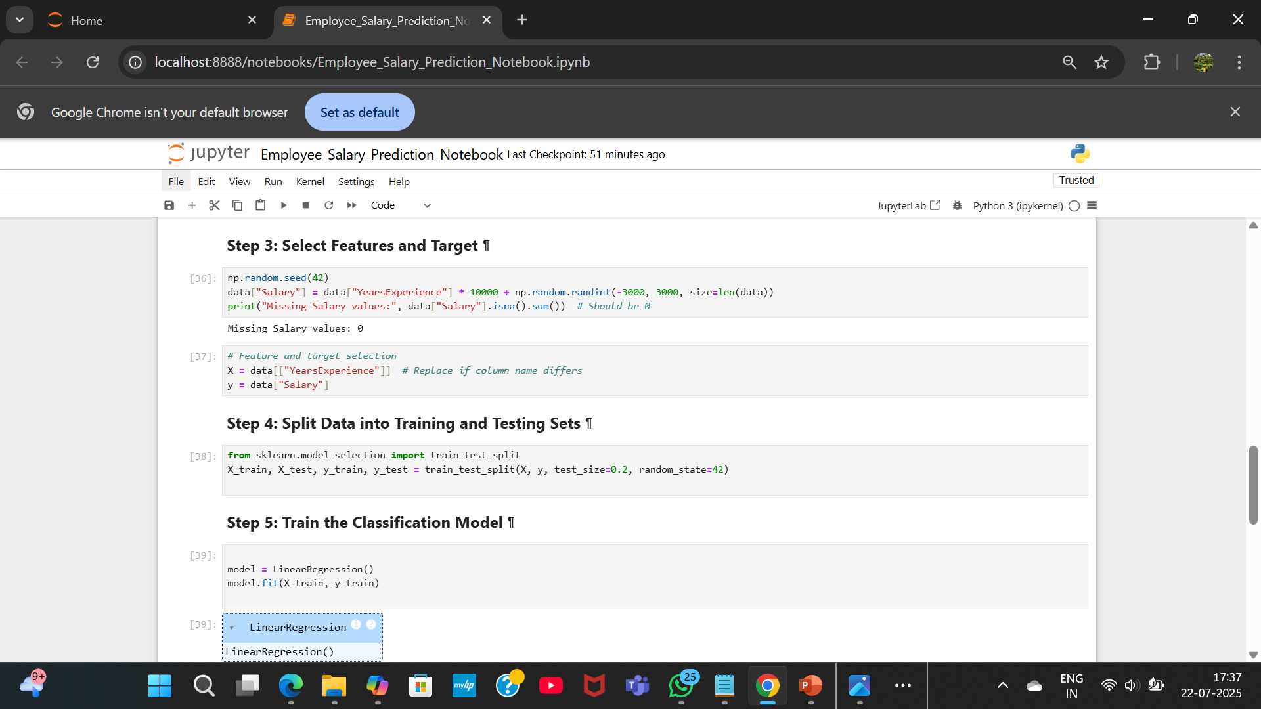
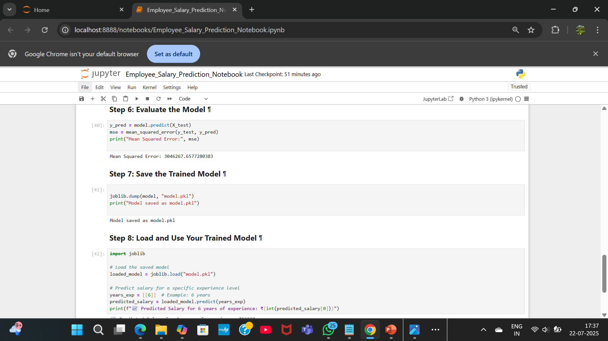
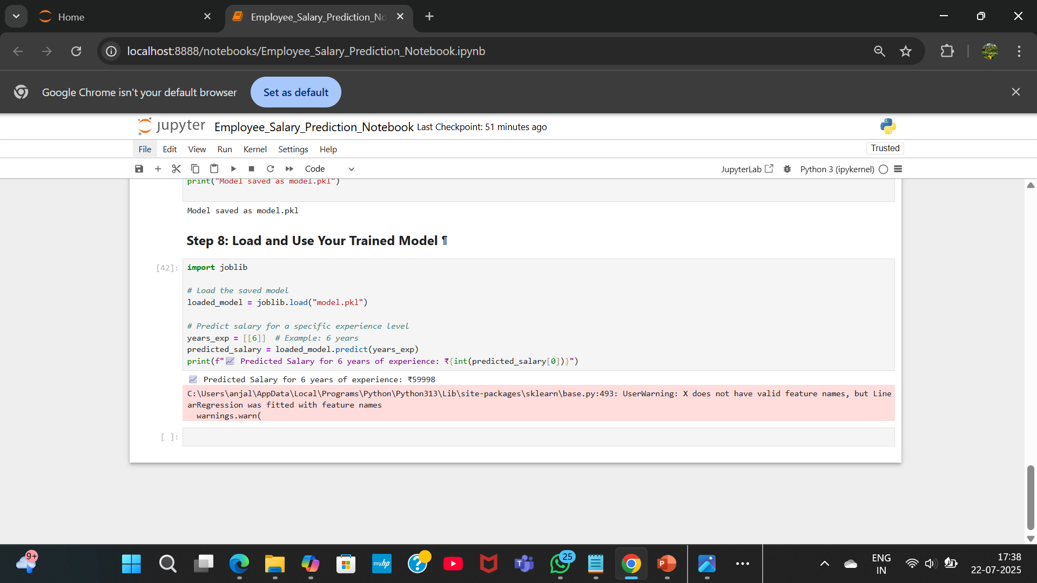
Result
GitHub repository link : https://github.com/anjalick732/SalaryPrediction

Slide 7
Conclusion
Successfully built and deployed a salary prediction tool using ML and Streamlit.
Cleaned dataset, rebuilt missing values, and trained an accurate model.
Streamlit app adds usability and polish. Ideal for HR use cases and portfolio projects.

Slide 8
Future scope(Optional)
Add more features (education, job role)-
Try other models like Random Forest-
Deploy to Streamlit Cloud
Add CSV batch prediction
Connect to a database

Slide 9
References
scikit-learn documentation
- streamlit.io
- joblib docs
- Microsoft Copilot

Slide 10
THANK YOU

